Slide 1
Discussion 1:
Intro to Java
Christine Zhou

Slide 2
Agenda
Introductions & About Me
Sections
Announcements
Git
Worksheet!

Slide 3
Introductions & About Me
Christine, 4th year
Email: cazhou@berkeley.edu (Feel free to email me! Always available to chat one-on-one)
Introduction speedround:
Name, year, major

Slide 4
Sections
Discussions
101: M 4 - 5 PM in 243 Dwinelle
123: M 2 - 3 PM in 405 Soda
Labs
115: Th 3 - 5 PM in 275 Soda
125: W 3 - 5 PM in 273 Soda
OH
W 11 - 12 PM in 109 Morgan
F 3 - 4 PM in 109 Morgan

Slide 5
Announcements
Lab 1, Lab 2, and HW 0 is due by this Friday at 11:59 PM.
Lab 2 will have an in-person lab checkoff. Attendance to some lab is required!
Office hours and discussion/lab calendars on the course website.
Discussion survey: https://tinyurl.com/cz-disc1-fa18

Slide 6
Git
VCS (version-control system), can save your work and go back to previous versions very easily
You have a central repository living somewhere stored by git
You can use git clone to get a copy of this central repository anywhere you want (ie. on your local computer and instructional account)
When you git push and git pull, you are interacting with your central repository.

Slide 7
Some Git Commands to Know
Camera analogy: local repository is your camera only capable of taking panoramic photos, central repository is a digital photo album
git add: take a snapshot of your files and puts it on the “stage” (this is called staging your changes)
Take a snapshot and save it on your camera
git commit (-m): take all snapshots on the “stage”, puts it together in a “commit” with a message, and saves it in your local repository
Save all the snapshots together into a panoramic photo with a message
git push: pushes all commits from your local repository to the central repository
Pushes all the panoramic photos from your camera to the digital photo album
git pull: pulls all commits from the central repository to your local repository
Pulls all the panoramic photos from the digital photo album to your camera

Slide 8
Some Git Commands to Know
git status: Shows the status of your local repository (what files have been modified but not staged, untracked files)
Shows the status of your camera
git log: Shows all the commits you’ve made on your local repository
Shows all the snapshots/corresponding messages you’ve made on your camera
git tag: Mark a specific commit with a tag
Mark a panoramic photo with a tag
Other useful commands are git checkout (will allow you to go back to previous versions), git branch (will allow you to switch branches), etc. Make sure to read the documentation before using these commands!

Slide 9
Repository Diagram
What is shared?
What is the central repository?
What is SSH?
Why do my local and instructional account repositories contain different files?

Slide 10
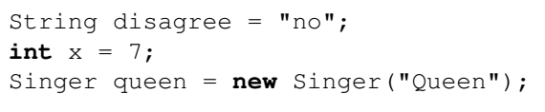
Javaian Rhapsody
Variable assignments, to different types (String, int, Singer)
String and int are provided in Java, Singer is a self-defined class!

Slide 11
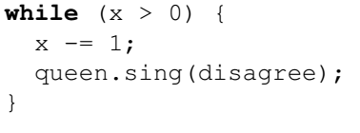
Javaian Rhapsody (continued)
While loops will continue as long as the condition is true
Condition in this case is x>0
Possible to loop infinitely if the condition is always true
Maybe we forget to decrement x?

Slide 12
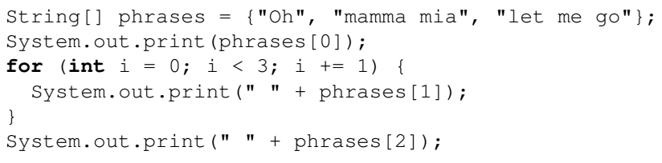
Javaian Rhapsody (continued)
Create arrays in Java with the bracket notation, can access with indexing
For loops: for (instantiation; condition; incrementation)
Will do what is within the brackets until the condition is false
System.out.print or System.out.println: how we print in Java!

Slide 13
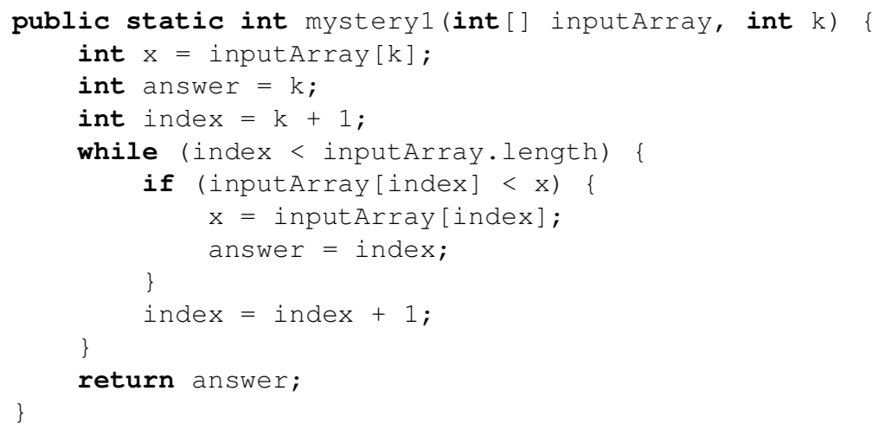
2. Mystery
Write the return value of mystery1 if inputArray is the array {3, 0, 4, 6, 3} and k is 2. Then, describe in English what mystery1 returns.

Slide 14
2. Mystery (continued)
Keep track of the variables when running through the example!
To determine what it’s doing, try to figure out what each of the variables stand for!

Slide 15
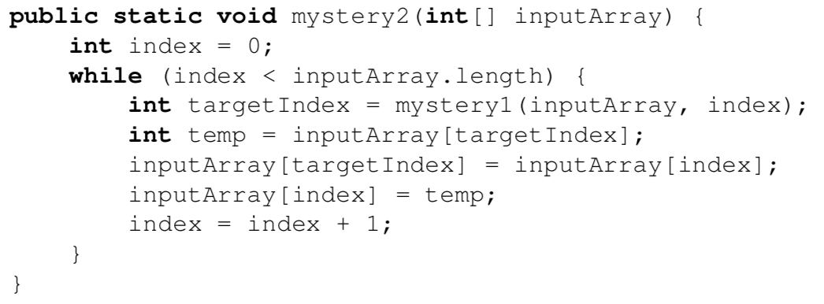
2. Mystery (continued)
Write what mystery2 will do if inputArray is the array {3, 0, 4, 6, 3}. Then, describe in English what mystery2 does.

Slide 16
2. Mystery (continued)
Keep track of variables when running through an example?
What does targetIndex represent? (What does mystery1 do?)

Slide 17
3. Fibonacci
Implement fib1 recursively. fib1 takes in an integer N and returns an integer representing the Nth Fibonacci number. The Fibonacci sequence is 0, 1, 1, 2, 3, 5, 8, 13, 21, . . . , where 0 is the 0th Fibonacci number.
Remember: If F_{i} is the i-th Fibonacci number, F_{N} = F_{N - 1} + F_{N - 2}.
Too many redundant calculations when done recursively…
What other way can we approach this?

Slide 18
3. Fibonacci (continued)
Implement fib2 in 5 lines or fewer that avoids redundant computation. fib2 takes in an integer N and helper arguments k, f0, and f1 and returns an integer representing the Nth Fibonacci number. If you’re stuck, try implementing fib1 iteratively and then see how you can transform your iterative approach to implement fib2.

